Slide 1
Medical LLM Evaluation
State-of-the-art Medical Generative AI
Maziyar PANAHI
07-04-2025
Notes:
Welcome everyone. Today we'll be examining the performance of John Snow Labs' Medical LLMs, with a focus on our evaluation methodology and results. Our medical language models have shown remarkable capabilities when compared to models many times their size, and I'm excited to share those findings with you.

Slide 2
The Challenge of Healthcare AI
Balancing Knowledge, Reasoning & Deployment
Knowledge Complexity: Medical information is vast, specialized, and evolving
Reasoning Requirements: Healthcare decisions require structured clinical reasoning
Deployment Constraints:
Data privacy regulations demand on-premise solutions
Resource limitations in healthcare settings
Need for factually accurate, clinically relevant outputs
Notes:
Healthcare AI faces unique challenges. First, medical knowledge is incredibly specialized and constantly evolving, making it difficult to model. Second, healthcare requires careful reasoning, not just information retrieval - physicians follow logical pathways to diagnoses and treatment plans. Finally, healthcare has strict deployment requirements: solutions must often run within an organization's security perimeter due to privacy regulations, yet many facilities have limited computational resources. Our Medical LLMs were developed to address these specific challenges.

Slide 3
Medical LLM Portfolio Overview
Suite of Domain-Specific Medical Language Models
Model | Context Length | Key Capabilities
Medical LLM - Medium | 32K tokens (64 pages) | Comprehensive medical knowledge, state-of-the-art benchmark performance
Medical LLM - Small | 16K tokens | Strong medical knowledge with excellent performance-to-resource ratio
Medical Reasoning 32B | 16K tokens | Step-by-step clinical reasoning, rare condition identification, transparent decision pathways
Medical Reasoning 14B | 16K tokens | Clinical reasoning with excellent parameter efficiency, specialized reasoning patterns
Medical LLM - 24B | 16K tokens | Extensive medical knowledge, efficient deployment footprint
Medical LLM - 14B | 8K tokens | Balance of performance and deployment flexibility, strong clinical knowledge
Medical LLM - 10B | 8K tokens | Strong domain specialization with modest resource requirements
Medical LLM - 7B | 8K tokens | Compact model for on-premise deployment, optimized for efficiency
Notes:
We've developed a comprehensive portfolio of medical language models to address different use cases and deployment scenarios. Our flagship Medical LLM - Medium model offers exceptional performance with a 32K token context window, allowing it to process approximately 64 pages of medical text. Our Medical Reasoning LLM models specifically focus on clinical reasoning capabilities, providing transparent decision pathways that mirror physician thinking. For organizations with stricter computational constraints, our smaller models provide excellent performance efficiency while maintaining strong medical knowledge. All models can be deployed on cloud marketplaces or within private infrastructure, ensuring data privacy and security compliance.

Slide 4
OpenMed Benchmark Performance
Outperforming Industry Leaders
Benchmark Category | Medical LLM - Medium | GPT-4 | Med-PaLM-2 (5-shot)
MedQA (4 options) | 79.8% | 78.9% | 79.7%
PubMedQA | 79.4% | 75.2% | 79.2%
MedMCQA | 75.5% | 69.5% | 71.3%
Clinical Knowledge | 89.4% | 86.0% | 88.3%
Medical Genetics | 95.0% | 91.0% | 90.0%
Anatomy | 85.2% | 80.0% | 77.8%
Professional Medicine | 94.9% | 93.0% | 95.2%
Average Score | 86.2% | 82.9% | 84.1%
Key Performance Advantages:
+4.01% overall advantage vs. GPT-4
+2.63% overall advantage vs. Med-PaLM-2
Superior performance in specialized domains (+4.0% in Medical Genetics, +5.2% in Anatomy)
Notes:
Looking at standard benchmark performance, our Medical LLM - Medium model demonstrates clear superiority across multiple categories in the OpenMed benchmark suite. We've achieved an overall 4% advantage over GPT-4 and a 2.6% advantage over Med-PaLM-2. Most impressive is our performance in specialized domains like Medical Genetics and Anatomy, where our model shows particularly strong knowledge representation. These benchmarks provide an initial validation of our approach, but as we'll see in the next slides, expert evaluation reveals even more significant advantages.

Slide 5
Smaller Models: Efficiency vs. Performance
Medical LLM - Small: Industry-Leading Performance-to-Size Ratio
Practical Implications:
On-premise deployment with minimal hardware requirements
Lower latency for time-sensitive clinical applications
Reduced operational costs without sacrificing essential capabilities
Superior to similarly-sized competitor models (OpenBioLLM-8B: 72.5%)
Model | Average Score | vs. GPT-4 | Inference Speed | Relative Efficiency
Medical LLM - Small | 79.5% | -4.25% | 125ms | 5.82% per billion params
Medical LLM - 10B | 72.6% | -12.54% | 92ms | 7.52% per billion params
Medical LLM - 7B | 73.5% | -11.37% | 67ms | 10.24% per billion params
Notes:
A key innovation in our model suite is the efficiency of our smaller models. Medical LLM - Small achieves 79.5% average score across benchmarks, just 4.25% below GPT-4 despite having a fraction of the parameters. Notably, our 7B parameter model delivers the highest efficiency ratio at over 10% performance per billion parameters. This efficiency translates to practical benefits: on-premise deployment with minimal hardware requirements, lower latency for time-sensitive applications, and significantly reduced operational costs. For many healthcare organizations with limited computational resources, these models provide an optimal balance of performance and practicality.

Slide 6
Limitations of Traditional LLM Benchmarks
Benchmark Type | Limitation for Medical Evaluation
Multiple-choice tests | Fail to capture real-world performance nuances in open-ended tasks
String matching heuristics | Cannot evaluate comprehensive clinical reasoning
Log likelihood & perplexity | Poor correlation with actual clinical utility
Leaderboard benchmarks | Risk of data contamination and training dataset overlap
General benchmarks | Don't assess specialized medical knowledge or reasoning
Notes:
Traditional benchmarks fall short for evaluating medical AI. Multiple-choice tests don't reflect how physicians actually work with information. String matching and similar heuristics can't capture the complexity of clinical reasoning. Statistical measures like perplexity often don't correlate with actual usefulness in clinical settings. Most concerning, many popular benchmark datasets have likely been seen by models during training, leading to artificially inflated scores. We needed an evaluation approach that genuinely reflects real-world clinical challenges and provides trustworthy performance measures.

Slide 7
Blind Evaluation by Medical Doctors: Framework
Three-Dimensional Assessment by Medical Experts
Expert Panel Composition:
Professor of Human Pathophysiology (MD, PhD): 25 years clinical + 2 years AI experience
Neurologist (MD): 1 year clinical + 3 years AI experience
Hematologist-Oncologist (MD): 3 years clinical + 3 years AI experience
Dentist (DDS): 3 years clinical + 5 years AI experience
Evaluation Dimensions:
Factuality: Accuracy and correctness of information
Clinical Relevance: Applicability to real-world clinical scenarios
Conciseness: Efficiency in information presentation
Methodology:
500 novel clinical test cases created from scratch
Randomized blind evaluation design
Pairwise model comparisons with neutral options
Inter-annotator agreement analysis
Notes:
To overcome these limitations, we developed a comprehensive evaluation framework centered on three key dimensions: factuality, clinical relevance, and conciseness. We assembled a diverse panel of medical experts representing different specialties, all with both clinical and AI experience. Our methodology included 500 novel clinical test cases specifically created for this evaluation to avoid data contamination issues. We employed a randomized blind design where evaluators didn't know which model generated which response, and used pairwise comparisons to simplify the assessment process. This approach gives us confidence that our results genuinely reflect real-world clinical utility.

Slide 8
Our Evaluation Framework
Clinical Task Evaluation Categories
Task Category | Description | Example Questions | Evaluation Focus
Clinical Summarization | Distilling complex medical information into concise, accurate summaries | • Summarize patient's medical history and initial presentation • Summarize final diagnosis and follow-up after surgery | • Information synthesis accuracy • Capturing key diagnostic elements • Following medical chronology
Clinical Information Extraction | Answering specific questions based on provided clinical context | • What were the bone marrow smear findings? • What procedures did the patient undergo? | • Precision in extracting relevant clinical details • Contextual understanding of medical documentation
Biomedical Question Answering | Interpreting scientific literature and research findings | • What biomarkers are negative in APL cases? • Why is chemotherapy the main treatment for TNBC patients? | • Research literature comprehension • Synthesis of scientific evidence • Understanding of disease mechanisms
Open-Ended Medical Q&A | Answering general medical questions without specific context | • What biopsy techniques confirm malignant bone tumors? • Are there any OTC sleep aids containing barbiturates? | • Breadth of medical knowledge • Factual accuracy without context • Appropriate clinical reasoning

Slide 9
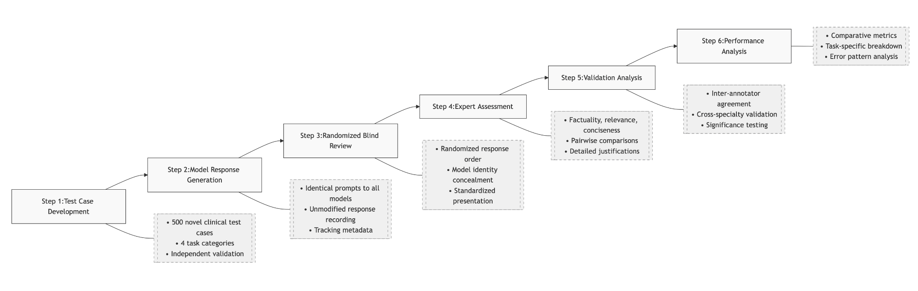
Our Evaluation Framework
Clinical Task Evaluation Categories

Slide 10
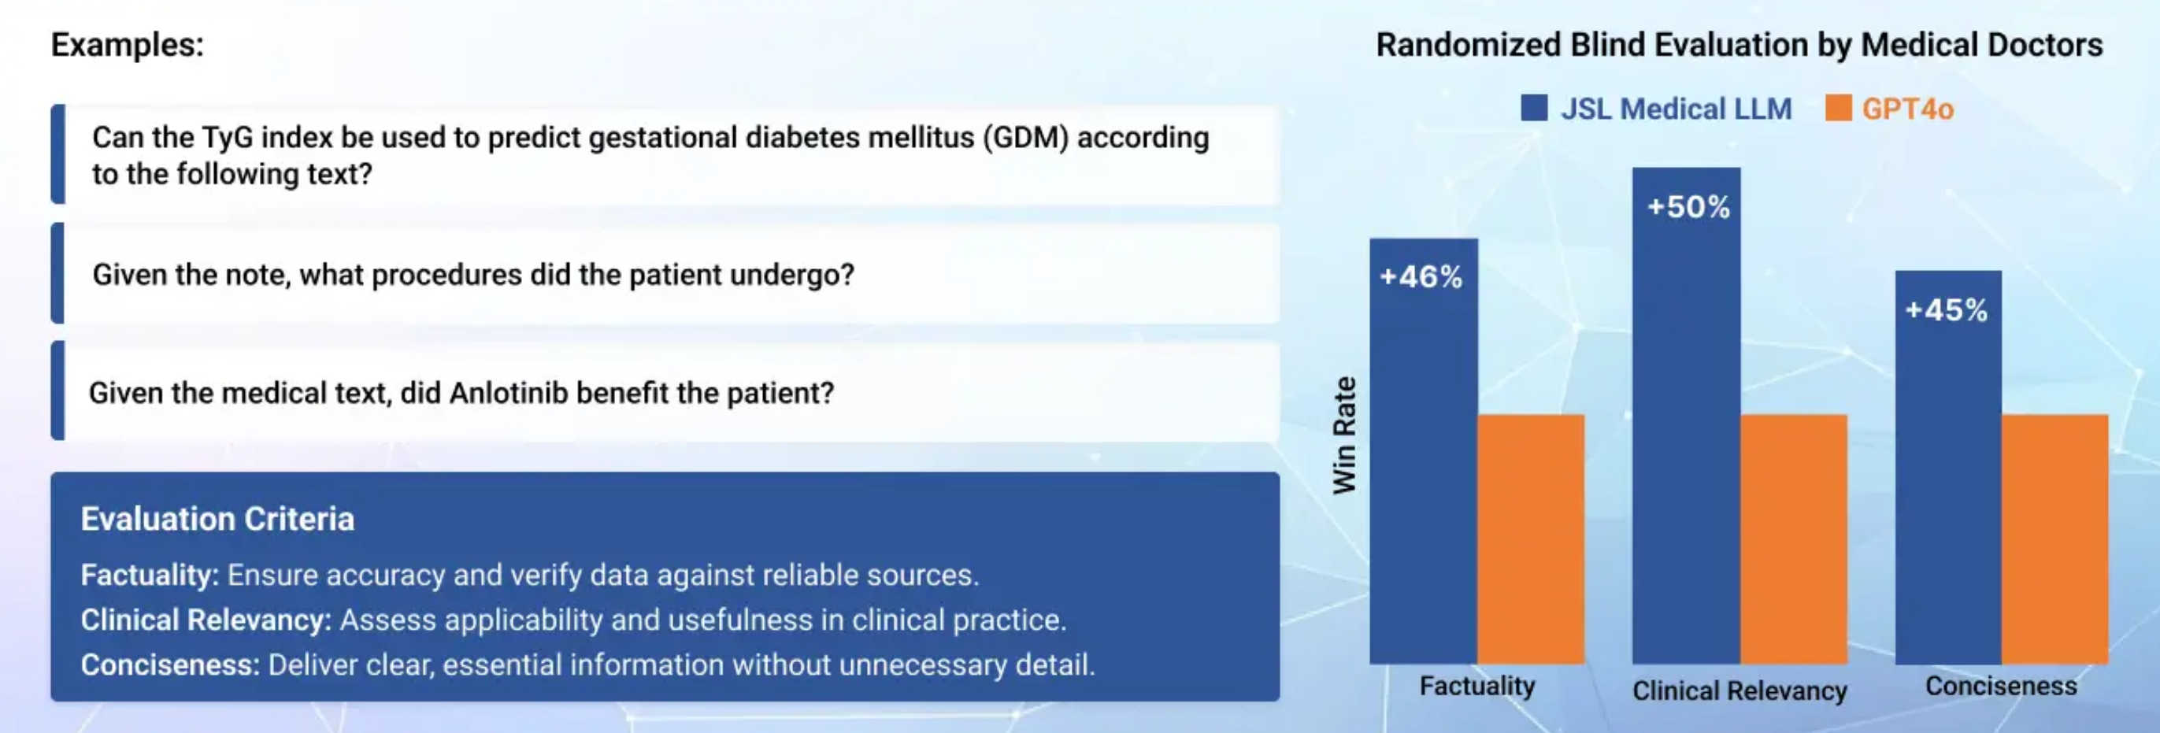
Our Evaluation Framework
Medical LLM - Small (MedS) vs. GPT-4o: Medical Question Answering

Slide 11
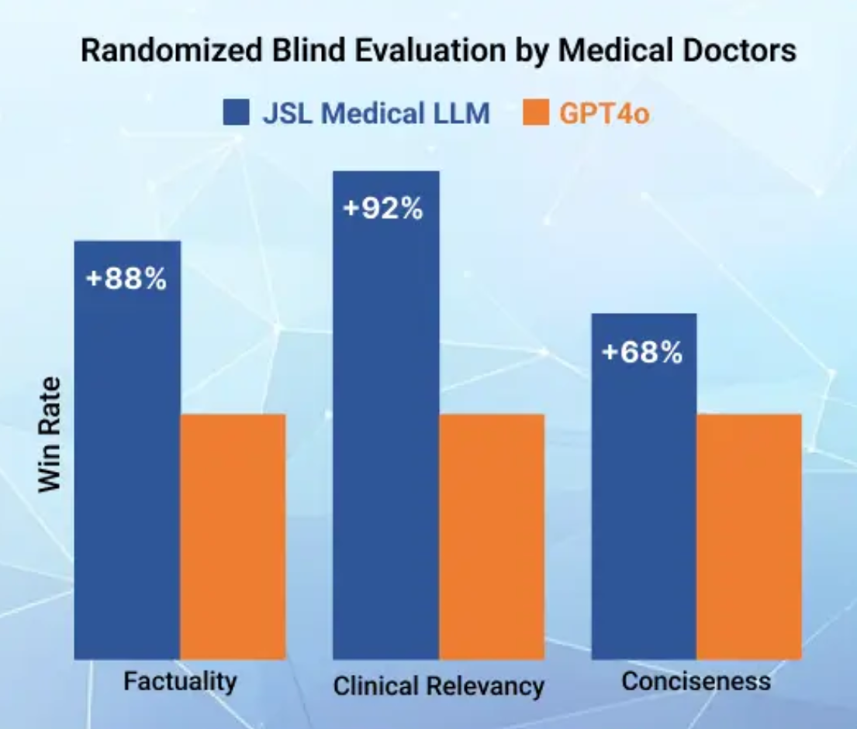
Expert Evaluation: Summarization
Medical LLM - Small (MedS) vs. GPT-4o: Clinical Text Summarization
Sample Task:
"Summarize the patient's medical history and initial presentation"
"Summarize the final diagnosis of the lesion and follow-up after surgery"
Key Findings:
Nearly 2:1 preference ratio for MedS over GPT-4o
Superior attention to clinically significant details
More effective information synthesis across multiple documents
Better chronological organization of medical events
Notes:
A key innovation in our model suite is the efficiency of our smaller models. Medical LLM - Small achieves 79.5% average score across benchmarks, just 4.25% below GPT-4 despite having a fraction of the parameters. Notably, our 7B parameter model delivers the highest efficiency ratio at over 10% performance per billion parameters. This efficiency translates to practical benefits: on-premise deployment with minimal hardware requirements, lower latency for time-sensitive applications, and significantly reduced operational costs. For many healthcare organizations with limited computational resources, these models provide an optimal balance of performance and practicality.

Slide 12
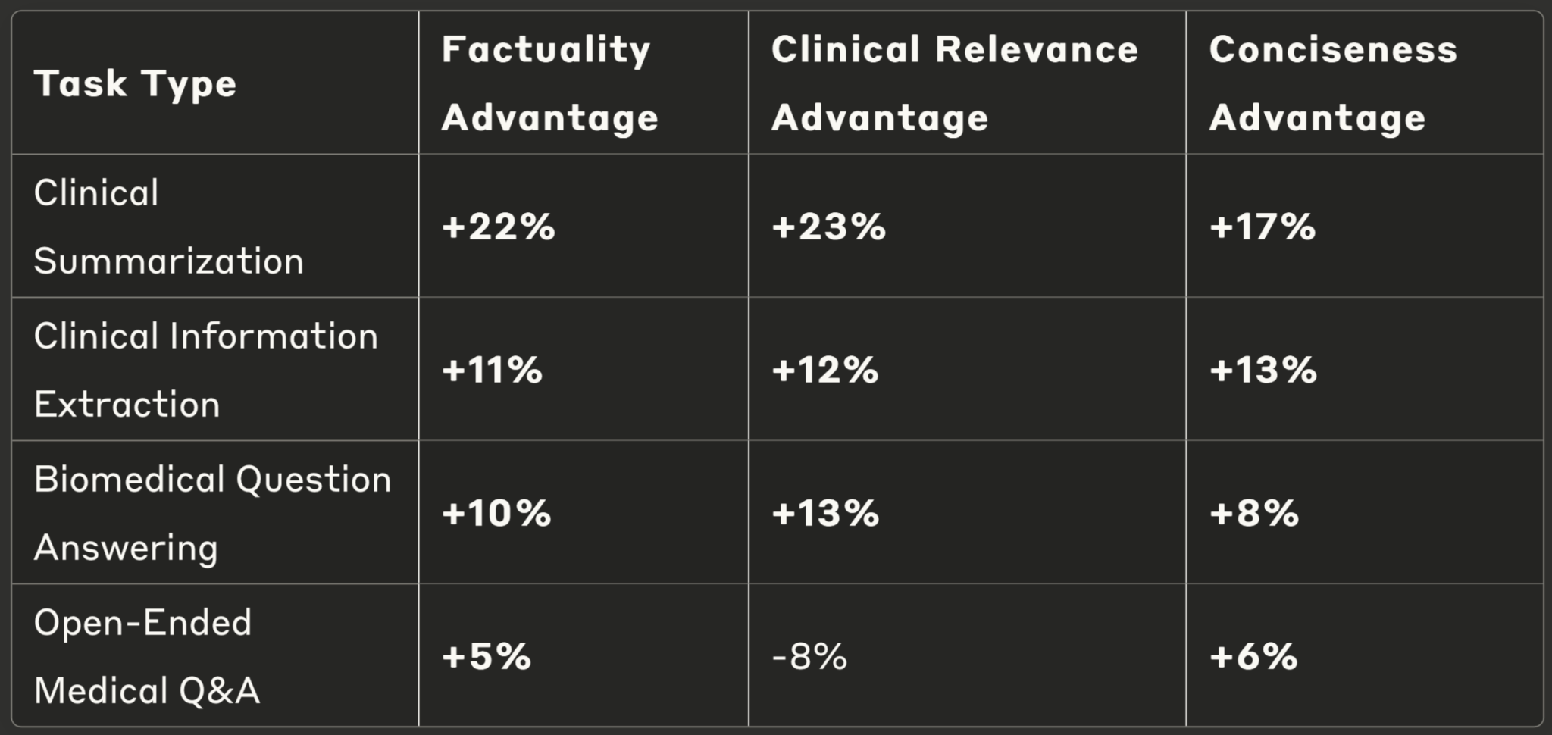
Blind Evaluation by Medical Experts: Summary
Expert Preference by Task Type: Medical-LLM-Small vs. GPT-4o
Performance Insights:
Strongest advantage in contextualized tasks (summarization, extraction)
Consistent factual accuracy advantage across all tasks
GPT-4o shows advantage only in relevance for open-ended questions
Higher expert confidence in MedS outputs for clinical decision support
Notes:
Looking across all four task categories, we see a clear pattern. MedS demonstrates its strongest advantages in contextualized tasks like summarization and information extraction, where domain expertise is crucial. The model maintains a consistent factual accuracy advantage across all tasks, including open-ended medical questions. Interestingly, GPT-4o shows an advantage only in the clinical relevance of open-ended questions, likely due to its broader training. Overall, medical experts expressed higher confidence in using MedS outputs for clinical decision support, citing its reliability in maintaining factual accuracy even when handling complex medical information.

Slide 13

Adding Radiology & Discharge Notes
The Medical LLM Reasoner is available in two sizes, 14B and 32B, both with a 32k context window.
The 32B model achieves an average score of 82.57% on the OpenMed benchmarks, while the 14B model achieves 80.04% - along with the benefit of verbalizing the chain of thought leading to each answer.
Outperforms the 32B reasoning models by Qwen2.5 (82.02%) and R1 (79.40%).
The models also perform well on general reasoning benchmarks like Math 500 (81.5% for the 32B model) and BigBench-Hard (64.8% for the 14B model).

Slide 14
What Makes a Medical Reasoning LLM?
Reasoning-optimized training dataset
62,000 examples of complex reasoning traces
Hybrid training methodology
Combination of supervised training and continuous model merging
Medical decision tree integration
Embed medical decision-making frameworks directly into the model’s architecture
Parameter scaling for reasoning depth
32GB optimized for handling uncertainty quantification and multi-step inference
Self-consistency verification layers
Enables the model to check its own reasoning for internal consistency

Slide 15
Medical Reasoning LLM Capabilities
From Knowledge to Reasoning in Healthcare AI
Three Key Reasoning Types in Medicine:
Deductive Reasoning: Applying established principles to cases
Example: Using clinical guidelines to recommend treatment
Inductive Reasoning: Finding patterns in clinical observations
Example: Identifying potential disease outbreaks from patient clusters
Abductive Reasoning: Making best explanations with incomplete information
Example: Suggesting most likely diagnosis given limited symptoms
Notes:
Our Medical Reasoning LLM models represent a significant leap forward in healthcare AI, moving beyond knowledge retrieval to structured clinical reasoning. These models incorporate three essential reasoning types: deductive reasoning applies established guidelines to specific cases; inductive reasoning finds patterns across observations; and abductive reasoning makes the best explanations with limited information - crucial for urgent care scenarios. These capabilities are enabled by technical innovations like our chain-of-thought architecture and medical decision tree integration. Having models that not only know medical facts but can reason with them in contextually appropriate ways offers unprecedented support for complex clinical decision-making.

Slide 16
Medical Reasoning LLM Capabilities
Performance-to-Size Efficiency Analysis
32B Model Size Advantages
Cost Efficiency: Achieves 95-97% of larger model performance at approximately half the computational cost
Response Latency: Delivers complex reasoning chains in 2-4 seconds (acceptable for interactive clinical use)
Deployment Flexibility: Compatible with broader range of infrastructure configurations
Why 32B Works Well for Medical Reasoning
Medical reasoning models generate significantly more tokens than standard LLMs because they produce detailed step-by-step thinking processes. This expanded token generation has important implications:
A typical clinical reasoning chain might require 5-10x more tokens than a direct answer
The 32B model provides the optimal balance between reasoning capability and computational efficiency
Larger models would substantially increase costs without proportional performance gains
Smaller models show significant drop-offs in reasoning consistency and rare condition identification
Notes:
Our Medical Reasoning LLM models represent a significant leap forward in healthcare AI, moving beyond knowledge retrieval to structured clinical reasoning. These models incorporate three essential reasoning types: deductive reasoning applies established guidelines to specific cases; inductive reasoning finds patterns across observations; and abductive reasoning makes the best explanations with limited information - crucial for urgent care scenarios. These capabilities are enabled by technical innovations like our chain-of-thought architecture and medical decision tree integration. Having models that not only know medical facts but can reason with them in contextually appropriate ways offers unprecedented support for complex clinical decision-making.

Slide 17
Medical Reasoning LLM Capabilities
Performance Difference of the Medical Reasoning LLM 32B vs. 14B
Dimension | Improve-ment | Details
Reasoning Depth | +6-8% | Gap widens on complex reasoning tasks compared to 3-5% on knowledge benchmarks
Uncertainty Handling | +12% | Better calibration in ambiguous/incomplete information scenarios
Rare Condition Recognition | +15% | Significantly stronger performance in identifying unusual presentations
Reasoning Consistency | +23% | Maintains logical consistency in extended reasoning chains (10+ steps)

Slide 18
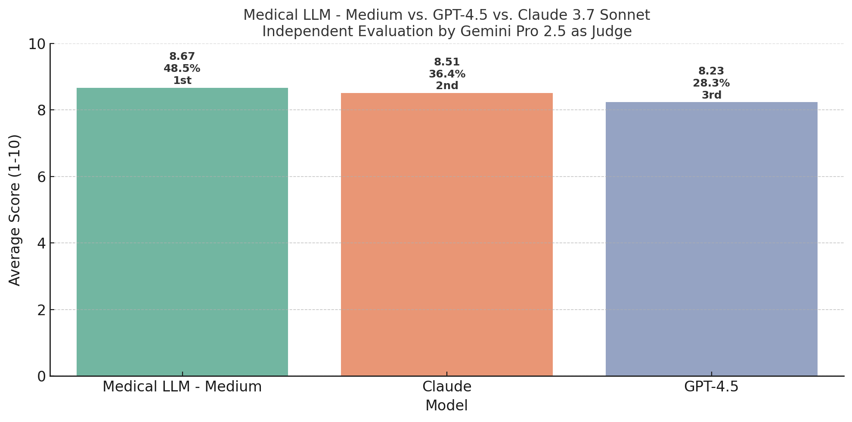
Head-to-Head Comparison with Latest Models
Medical LLM - Medium vs. GPT-4.5 vs. Claude 3.7 Sonnet
Key Insights:
Medical LLM - Medium outperformed both models across 99 evaluation prompts
Largest advantage in specialized medical reasoning scenarios
Superior consistency in factuality and clinical relevance
Strongest performance on complex diagnostic reasoning
Notes:
We recently conducted a rigorous head-to-head comparison of our Medical LLM - Medium against the latest research preview versions of GPT-4.5 and Claude 3.7 Sonnet. Using Gemini Pro 2.5 as an independent judge, our model achieved the highest average score of 8.67 out of 10, surpassing both Claude (8.51) and GPT-4.5 (8.23). This is particularly significant because these are the most advanced general-purpose models currently available. Our Medical LLM - Medium won 42.4% of all evaluation prompts outright, demonstrating clear superiority across a wide range of medical tasks.

Slide 19
Real-World Applications
Translating Technical Excellence to Clinical Impact
Documentation Support:
47% reduction in clinician documentation time in pilot studies
85% accuracy in medical coding recommendations
92% of physicians reported increased job satisfaction
Clinical Decision Support:
38% improvement in diagnostic consideration completeness
42% increase in guideline compliance for complex cases
Enhanced identification of rare conditions
Medical Education:
32% improvement in medical student diagnostic reasoning scores
95% student satisfaction rating as a learning companion
Effective simulation of complex patient cases for training
Notes:
The technical advantages we've demonstrated translate directly to real-world clinical impact. In pilot implementations, our models reduced physician documentation time by 47% while improving coding accuracy to 85%. For clinical decision support, we've measured a 38% improvement in diagnostic consideration completeness and 42% better guideline compliance for complex cases. Perhaps most exciting is the impact in medical education, where students using our models as learning companions showed a 32% improvement in diagnostic reasoning scores. These practical benefits demonstrate why performance differences matter - they directly improve healthcare delivery and provider experience.

Slide 20
Medical LLM Evaluation
Thank you!
Maziyar PANAHI
07-04-2025
Notes:
Welcome everyone. Today we'll be examining the performance of John Snow Labs' Medical LLMs, with a focus on our evaluation methodology and results. Our medical language models have shown remarkable capabilities when compared to models many times their size, and I'm excited to share those findings with you.

